Slide 1
ThermiTight® and ThermiSmooth® Face
Sample Content Calendar
MC-ARV-SM-0009 REV A 2/2019

Slide 2
APRIL

Slide 3
April Week 1
Plan
Plan
Plan
▶ Upload Date: April 1st
▶ April Fool’s Day
▶ Copy: Be a little silly and post a prank picture!
▶ Hashtags: #AprilFoolsDay #JK #Gotcha
▶ Upload Date: April 3rd
▶ ThermiTight
▶ Copy: Not ready for surgery but are looking for a treatment for your abs that you just can’t define in the gym? Call us today to see if #ThermiTight is right for you
▶ Hashtags: #StrutYourStuff #SummerBodyGoals #SummerTime #Goals #YourPracticeName #YourProviderName
▶ Upload Date: April 5th
▶ Fun Fact Friday
▶ Copy: (Have an interesting fact about your practice or about a treatment that you provide? Post it!)
▶ Hashtags: #FunFactFriday #Friyay #Weekend

Slide 4
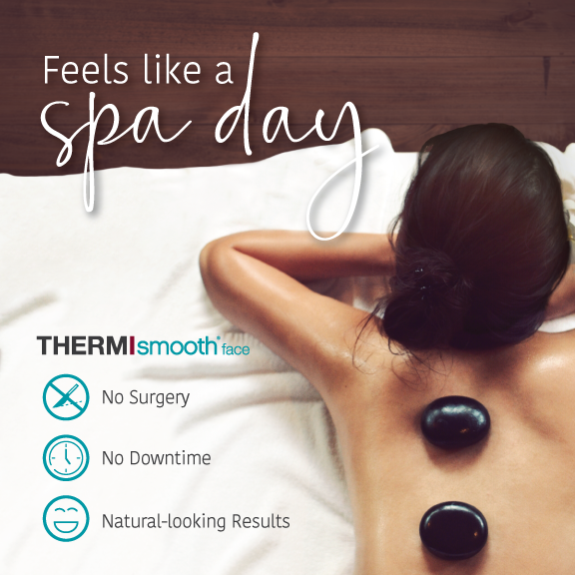
April Week 2
Plan
Plan
Plan
▶ Upload Date: April 8th
▶ ThermiSmooth Face
▶ Copy: Mondays can be stressful. Come in for a quick, no downtime #ThermiSmoothFace treatment and feel the comfort of gentle #radiofrequency heat.
▶ Hashtags: #StrutYourStuff #NoDowntime #NoSurgery #Thermi #YourPracticeName #YourProviderName
▶ Upload Date: April 10th
▶ A Day in the Life
▶ Copy: (Give your followers a tour of your office) Here at (practice name), we offer a comfortable atmosphere for our patients. Come see it for yourself!
▶ Hashtags: #OfficeTour #YourPracticeName #YourProviderName
▶ Upload Date: April 12th
▶ ThermiTight
▶ Copy: Get ready for a natural, more youthful-looking appearance this Spring with #ThermiTight! Call us today for (enter discount/promotional rate) off your treatment!
▶ Hashtags: #SpringIsHere #YourPracticeName #YourProviderName #BeforeAndAfter

Slide 5
April Week 3
Plan
Plan
Plan
▶ Upload Date: April 15th
▶ ThermiSmooth Face
▶ Copy: You don’t have to have surgery to look your best! Call us today and receive (enter discount here) off of your #ThermiSmoothFace treatment package!
▶ Hashtags: #StrutYourStuff #NoDowntime #NoSurgery #Thermi #Radiofrequency #YourPracticeName #YourProviderName
▶ Upload Date: April 17th
▶ Ask Your Audience A Question
▶ Copy: (Post a picture of your favorite weekend activity) The weekend is almost here and we’re looking forward to _________. What are your plans this weekend?
▶ Hashtags: #Wednesday #HumpDay #CantWait
▶ Upload Date: April 19th
▶ ThermiTight
▶ Copy: You don’t have to have surgery to get the #SummerBody you want! Call us today for a free consultation on single-treatment #ThermiTight!
▶ Hashtags: #StrutYourStuff #SummerBodyGoals #SummerTime #BikiniBody #Goals #YourPracticeName #YourProviderName

Slide 6
April Week 4
Plan
Plan
Plan
▶ Upload Date: April 22nd
▶ Motivation Monday
▶ Copy: (Post a motivational quote)
▶ Hashtags: #MotivatonMonday #YouGotThis #YourPracticeName
▶ Upload Date: April 24th
▶ Unbranded: ThermiTight
▶ Copy: Mother’s Day is just around the corner, and #ThermiTight makes a great present! Call us today for (enter promotional rate/discount here) off!
▶ Hashtags: #MothersDay #Gift #Thermi #StrutYourStuff #YourPracticeName #YourProviderName
▶ Upload Date: April 26th
▶ Weekend Poll
▶ Copy: Are you staying in or going out on an adventure? Comment below and let us know what your plans are for the weekend!
▶ Hashtags: #Friyay #Weekend #YourPracticeName #YourProviderName

Slide 7
April Week 5
Plan
▶ Upload Date: April 29th
▶ Brand: ThermiSmooth Face
▶ Copy: #ThermiSmooth Face makes the perfect gift for Mother’s Day, or for yourself! Save (enter promotional rate/discount) on your treatment packages now through Mother’s Day!
▶ Hashtags: #MothersDay #Gift #Spring #Natural #YourPracticeName #YourProviderName

Slide 8
May

Slide 9
May Week 1
Plan
Plan
▶ Upload Date: May 1st
▶ Wellness Wednesday
▶ Copy: Share your favorite skin care tip! Ex. Happy May 1st! As we get closer to summer, it’s important to protect your skin from the sun’s harmful rays. We recommend wearing sunscreen everyday, even when it’s cloudy!
▶ Hashtags: #WellnessWednesday #Sunscreen #SkinCare #YourPracticeName #YourProviderName
▶ Upload Date: May 3rd
▶ Brand: ThermiTight
▶ Copy: You deserve a mommy makeover! Give yourself the gift of #ThermiTight! Now through Mother’s Day, we’re offering (enter promotional rate/discount) off of your treatment!
▶ Hashtags: #MothersDay #StrutYourStuff #Gift #Thermi #YourPracticeName #YourProviderName

Slide 10
May Week 2
Plan
Plan
Plan
▶ Upload Date: May 6th
▶ Patient Testimonial
▶ Copy: (Share a patient testimonial! It can be a quote or a video)
▶ Hashtags: #RealPatients #Testimonial #TreatmentName #YourPracticeName #YourProviderName
▶ Upload Date: May 8th
▶ Brand: ThermiSmooth Face
▶ Copy: For a naturally refreshed appearance this Spring, get #ThermiSmoothFace! It takes less than 30 minutes and no downtime so you can get back to your day. Call us to book your consultation!
▶ Hashtags: #StrutYourStuff #LunchTimeTreatment #YourPracticeName #YourProviderName
▶ Upload Date: May 10th
▶ Weekend Ready
▶ Copy: It’s Friyay! Have a great weekend, everyone! (Share a fun photo or video of a weekend activity).
▶ Hashtags: #Weekend #Friyay #YourPracticeName

Slide 11
May Week 3
Plan
Plan
Plan
▶ Upload Date: May 13th
▶ Brand: ThermiTight
▶ Copy: Wedding season is here! Get ready with single-treatment #ThermiTight. Call us for a free consultation and #StrutYourStuff down that aisle!
▶ Hashtags: #NoSurgery #WeddingSeason #YourPracticeName #YourProviderName
▶ Upload Date: May 15th
▶ Wellness Wednesday
▶ Copy: (Share your favorite wellness tip).
▶ Hashtags: #WellnessWednesday #HumpDay #YourPracticeName #YourProviderName
▶ Upload Date: May 17th
▶ Brand: ThermiSmooth Face
▶ Copy: (Post a picture or video performing ThermiSmooth Face). We <3 #ThermiSmoothFace! If you call us today to book your consultation, you will save (enter discount here) on your treatment package!
▶ Hashtags: #NaturalResults #NoSurgery #StrutYourStuff #YourPracticeName #YourProviderName

Slide 12
May Week 4
Plan
Plan
Plan
▶ Upload Date: May 20th
▶ Motivation Monday
▶ Copy: (Post a motivational quote)
▶ Hashtags: #MotivatonMonday #NewWeek #NewGoals #YourPracticeName
▶ Upload Date: May 22nd
▶ Brand: ThermiTight
▶ Copy: Father’s Day is just around the corner! Treat yourself to non-surgical #ThermiTight for that extra help getting the body you want!
▶ Hashtags: #FathersDay #Dad #OneAndDone #Gift #StrutYourStuff #YourPracticeName #YourProviderName
▶ Upload Date: May 24th
▶ Fun Fact Friday
▶ Copy: (Have an interesting fact about your practice or about a treatment that you provide? Post it!)
▶ Hashtags: #FunFactFriday #Friyay #Weekend

Slide 13
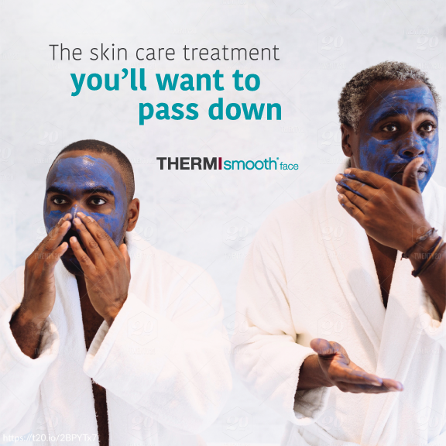
May Week 5
Plan
Plan
Plan
▶ Upload Date: May 27th
▶ Brand: ThermiSmooth Face
▶ Copy: Dads deserve to have a more youthful-looking appearance, too! Call us to schedule a #ThermiSmoothFace treatment for the special guys in your life.
▶ Hashtags: #FathersDay #Gift #NoSurgery #NoDowntime #YourPracticeName #YourProviderName
▶ Upload Date: May 29th
▶ Hump Day Giveaway
▶ Copy: It’s Hump Day! Like our post and tag a friend and you could win (enter prize or discount on treatment)!
▶ Hashtags: #HumpDay #Giveaway #TreatmentNameHere #YourPracticeName #YourProviderName
▶ Upload Date: May 31st
▶ Before & After
▶ Copy: (Post a before & after photo from one of your treatments). Check out this Before & After on our (enter treatment) patient! Call us and book an appointment today!
▶ Hashtags: #BeforeAndAfter #Transformation #TreatmentNameHere #YourPracticeName #YourProviderName

Slide 14
June

Slide 15
June Week 1
Plan
Plan
Plan
▶ Upload Date: June 3rd
▶ Motivational Monday
▶ Copy: Happy June! (Post a motivational quote)
▶ Hashtags: #MotivationMonday #June #SummerIsComing
▶ Upload Date: June 5th
▶ Brand: ThermiTight
▶ Copy: #ThermiTight may help with those areas you can’t work out at the gym. Call us today and see if single-treatment, non-surgical ThermiTight is right for you!
▶ Hashtags: #WeddingSeason #Neck #SuitAndTie #NoSurgery #YourPracticeName #YourProviderName
▶ Upload Date: June 7th
▶ Fun Fact Friday
▶ Copy: (Have an interesting fact about your practice or about a treatment that you provide? Post it!)
▶ Hashtags: #FunFactFriday #Friyay #Weekend

Slide 16
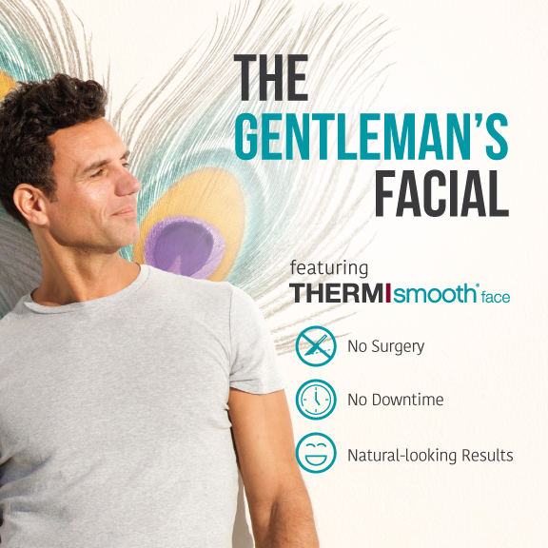
June Week 2
Plan
Plan
Plan
▶ Upload Date: June 10th
▶ ThermiSmooth Face
▶ Copy: Non-surgical #ThermiSmoothFace is a great gift for the men in your life! Call us today for (promotional discount) off ThermiSmooth Face packages!
▶ Hashtags: #NoDowntime #NoDowntime #Gift #FathersDay #Gentlemen #YourPracticeName #YourProviderName
▶ Upload Date: June 12th
▶ ▶ Patient Testimonial
▶ Copy: (Share a patient testimonial! It can be a quote or a video)
▶ Hashtags: #RealPatients #Testimonial #TreatmentName #YourPracticeName #YourProviderName
▶ Upload Date: June 14th
▶ Brand: ThermiSmooth Face
▶ Copy: You deserve to look and feel your best on your big day! Call us and book your #ThermiSmoothFace treatment today and receive (enter promotional rate/discount)!
▶ Hashtags: #NoDowntime #NoSurgery #WeddingSeason #Confidence #Smile #YourPracticeName #YourProviderName

Slide 17
June Week 3
Plan
Plan
Plan
▶ Upload Date: June 17th
▶ Brand: ThermiTight
▶ Copy: Have some troublesome areas that could use a little help? Non-surgical, single-treatment #ThermiTight may be right for you! Call us for a free consultation and receive (enter promotional rate/discount) off when you book your treatment!
▶ Hashtags: #OneAndDone #SwimsuitSeason #SummerBody #Goals #StrutYourStuff #Thermi
▶ Upload Date: June 19th
▶ Celebrity Before & After
▶ Copy: (Enter celebrity’s name) has changed over the years! We’re guessing they’ve had (enter treatments here). What do you think of their transformation?
▶ Hashtags: #Celebrity #Transformation
▶ Upload Date: June 21st
▶ First Day of Summer
▶ Copy: Happy First Day of Summer!
▶ Hashtags: #SummerIsHere #Summer2019 #YourPracticeName #YourProviderName

Slide 18
June Week 4
Plan
Plan
Plan
▶ Upload Date: June 24th
▶ Brand: ThermiSmooth Face
▶ Copy: #ThermiSmoothFace is the perfect treatment for the entire wedding party! Look #PicturePerfect for the big day with (enter promotional rate/discount) off of your treatment package!
▶ Hashtags: #WeddingSeason #Smile #Confidence #StrutYourStuff ##YourPracticeName #YourProviderName
▶ Upload Date: June 26th
▶ Wellness Wednesday
▶ Copy: (Share your favorite wellness tip).
▶ Hashtags: #WellnessWednesday #HumpDay #YourPracticeName #YourProviderName
▶ Upload Date: June 28th
▶ Brand: ThermiTight
▶ Copy: Dare to bare your skin! Get some Summer #Confidence with #ThermiTight!
▶ Hashtags: #NoSurgery #NoDowntime #YourPracticeName #YourProviderName

